Slide 1

Global Economic Prospects
January 2023 www.worldbank.org/gep
Notes:
Thank you. Great to be here and present a summary of the GEP to the Board ahead of the launch date of January 10.***

Slide 2
Global Economic Prospects – January 2023
Global Outlook (Chapter 1)
Regional Outlooks (Chapter 2)
Investment Growth After the Pandemic (Chapter 3)
Small States: Overlapping Crises, Multiple Challenges (Chapter 4)
Notes:
In addition to the global and regional outlook chapters, this edition of the GEP includes analytical pieces on investment growth and challenges of small states.

Slide 3
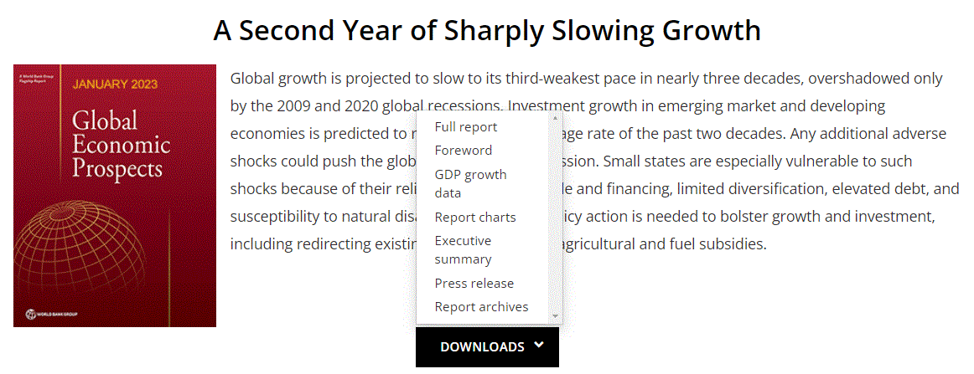
Global Economic Prospects – January 2023
Underlying data and charts can be found at
www.worldbank.org/gep

Slide 4
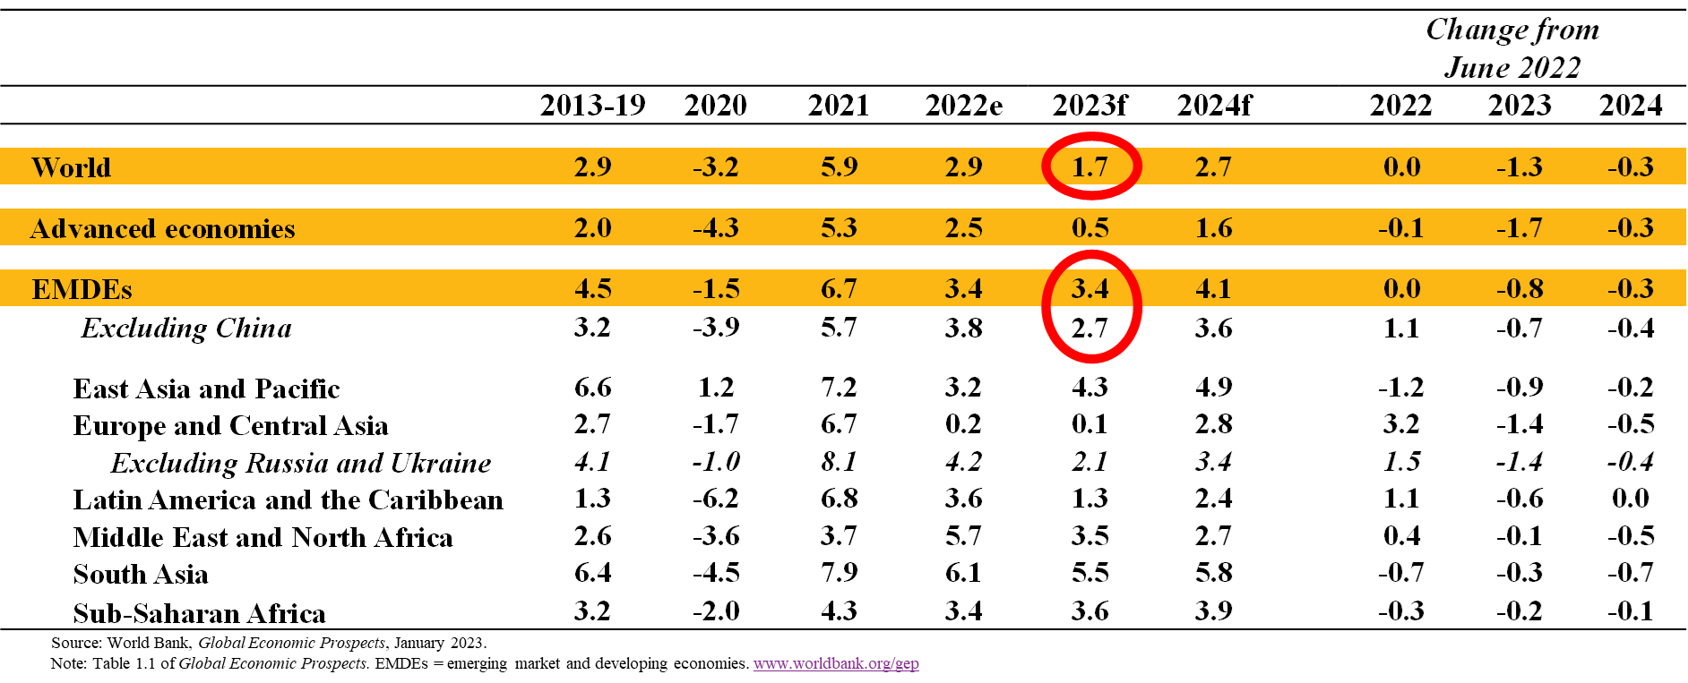
Growth Forecasts
A Sharp Downturn in 2023
GDP growth
(Percent)
Notes:
Global activity has slowed to the extent that the global economy is perilously close to falling into recession. Very high inflation has triggered rapid and synchronous monetary policy tightening, which has contributed to a significant worsening of global financial conditions. Commodity prices have experienced substantial volatility amid ongoing disruptions to energy markets. The world’s major engines of growth—the United States, the euro area, and China—are ongoing a pronounced period of weakness. The associated spillover effects will compound the challenges facing EMDEs already struggling with weakening domestic conditions.
In all, global growth is expected to decelerate to 1.7 percent in 2023—the third weakest pace of growth in nearly three decades, overshadowed only by the global recessions caused by the pandemic in 2020 and the global financial crisis in 2009. This is 1.3 percentage points below previous forecasts, reflecting synchronous policy tightening aimed at containing very high inflation, worsening financial conditions, and continued disruptions from Russia’s invasion of Ukraine.
In AEs, activity has deteriorated sharply, owing to declining confidence alongside high inflation and rapid monetary policy tightening. In the United States, one of the most aggressive monetary policy tightening cycles in recent history is expected to slow growth sharply. The euro area is also contending with severe energy supply disruptions and price hikes associated with the invasion of Ukraine. Growth in advanced economies is forecast to slow from 2.5 percent in 2022 to 0.5 percent in 2023—the fourth fastest deceleration of the past 50 years, with all the sharper slowdowns foreshadowing a global recession.
In EMDEs, growth prospects have worsened materially, with the forecast for 2023 downgraded 0.8 percentage point to a subdued 3.4 percent—this is the slowest pace of growth since 2001 (outside of the global recessions in 2009 and 2020) and comes on the heels of the sharp slowdown in 2022. The deterioration is broad-based, with forecasts for 2023 growth downgraded in two-thirds of EMDEs.
Excluding China, EMDE growth is forecast to decelerate sharply, from 3.7 percent in 2022 to 2.8 percent in 2023 as significantly weaker external demand is compounded by high inflation, tighter financial conditions, and other domestic headwinds. [The only regions that are expected to see a pickup are Sub-Saharan Africa and East Asia and the Pacific, but both are starting from subdued growth in 2022.]
In EAP, China’s growth next year has been downgraded markedly [0.9 ppt, to 4.3 percent] primarily due to longer-than-expected pandemic-related disruptions, weaker external demand, and protracted weakness in the real estate sector, and is expected to remain well below pre-pandemic averages. Growth in EAP excluding China is expected to decelerate as external demand softens.
Growth is weakest in ECA, with output virtually flat for the second year in a row, reflecting a deep contraction in Russia. Elsewhere in the region, growth remains weak, with consumption suppressed by large falls in real wages in many countries and spillovers from Russia.
The outlook in LAC in 2023 is for anemic growth of just 1.3 percent. A regional recovery that was boosted by commodity exports is set to rapidly unwind amid tight monetary policy.
In MENA, accelerating growth driven by rising energy prices is now in the past. The region is set to slow sharply in 2023, to 3.5 percent, moving back towards pre-pandemic growth rates as oil prices moderate and export growth slows sharply.
SAR is expected to be the fastest growing region again in 2023, reflecting its higher potential growth rates. Nonetheless, growth is set to slow markedly, to 5.5 percent in 2023, as activity in India decelerates due to weaker investment and export growth.
In SSA, growth is projected to edge up marginally, to 3.6 percent. This is set to be too small an improvement to substantially reverse recent increases in poverty.

Slide 5
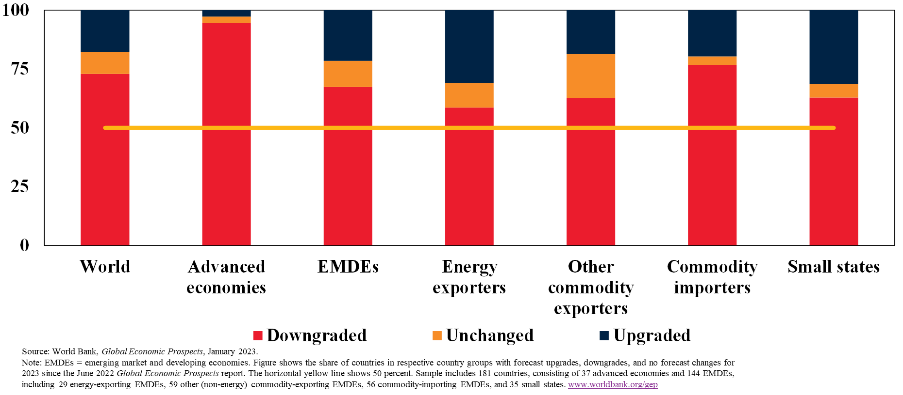
Changes in Growth Forecasts for 2023
Downgrades for Most Countries
Country groups by the type of growth forecast revisions since June for 2023
(Percent of countries)

Slide 6
Risks
Multiple and Interconnected Downside Risks
Notes:
This grim outlook is subject to multiple downside risks, which are organized into three groups on this slide.
In the first group, we have risks associated with elevated inflation and financial dislocations. The baseline forecasts assume that central banks tighten monetary policy broadly in line with market expectations and are able to bring inflation down without triggering significant financial stress. However, more persistent inflation may require central banks to tighten monetary policy more than currently expected, leading to weaker growth and heightening the possibility of increased financial stress in EMDEs.
In the second group, we have serious risks related to geopolitical tensions its implications and the possibility of pandemic-related disruptions. The possibility of geopolitical turmoil rose markedly after Russia’s invasion of Ukraine and could increase further and encompass a larger set of countries. This could hasten the trend toward the fragmentation of global trade, investment, and financial networks and disrupt the supply of commodities, leading to heightened energy and food insecurity. In particular, food insecurity remains a critical risks in some EMDEs, reflecting the high number of food trade restrictions imposed last year, weather-related events, and the impact of the invasion of Ukraine and conflict elsewhere. This could also exacerbate social tensions. New COVID-19 outbreaks could lead to the re-introduction of control measures and renewed restrictions. This is a particularly important risks to China, with global implications.
In the third group, we have broader risks related to both short- and longer-term challenges. The risk of major climate-related disasters is growing, as changing weather patterns contribute to increasingly disruptive events, such as heat waves, droughts and floods. In the near term, climate-related disasters can substantially weigh on activity; in the longer term, climate change can render some populated area uninhabitable, lower productivity, and worsen global poverty. The materialization of any of these risks could lead to weaker longer-term growth prospects—which were already deteriorating over the past decade—weighing heavily on long-run growth prospects and increasing inequality and poverty.

Slide 7
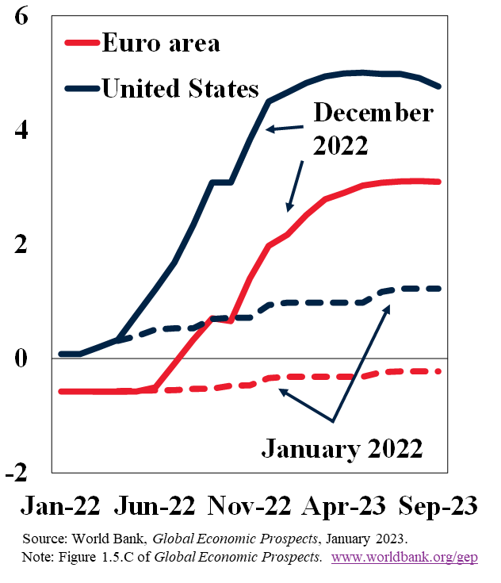
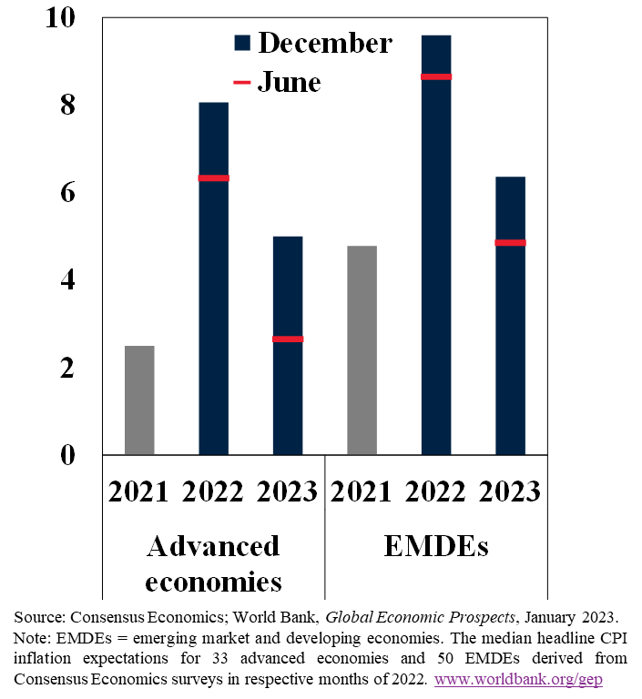
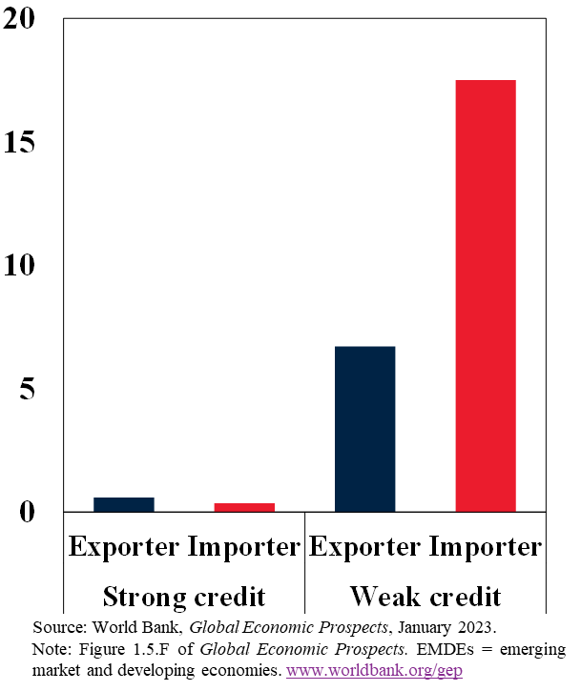
Monetary Policy and Financial Markets
Higher Interest Rates; Elevated Inflation; Tighter Financial Conditions
Interest rate expectations
(Percent)
Survey-based inflation expectations
(Percent)
EMDE sovereign spread changes, 2022
(Percentage points, by energy trade)
Notes:
Let me elaborate on a key risk, related to monetary policy and financial strains.
Left panel: One key risk related to the current tightening cycle stems from its rapid and synchronous nature. Historically, at the start of policy tightening episodes, market-based interest rate expectations in the United States have underestimated the subsequent cumulative rate increases by an average of 85 basis points. The shift in expectations during the current policy tightening cycle has been considerably larger—between the beginning and the end of 2022, the average policy rate expectation for 2023 was revised up by more than 325 basis points, and further upward revisions remain possible.
Middle panel: Aggressive policy tightening by major central banks came in response to sharply higher global inflation. Median global headline inflation exceeded 9 percent in the second half of the 2022, its highest level since 1994, while global core inflation reached over 6 percent late last year, its highest level since 1992. Importantly, inflation expectations for 2023 have increased sharply across AEs and EMDEs. The shift in expectations from February to November illustrates the scale of uncertainty about future inflation. Were inflation to shift up further, real incomes would decline further, central banks would be forced to tighten accordingly, and global growth would be weaker than expected.
Right panel: Sharp tightening in global financial conditions and reduced risk appetite weighed on EMDE capital flows, as investors increasingly shied away from the debt of the most vulnerable EMDEs. Energy importers with weak credit ratings saw especially sharp increases in sovereign spreads, adding to the difficulty of financing large current account deficits. Around one-in-five EMDEs is effectively
locked out of global debt markets, with spreads in excess of 10 percentage points, up from one-in-fifteen in 2019. Growing pressures on EMDEs could result in currency crises or widespread private and public defaults, with potential cross-border spillovers.

Slide 8
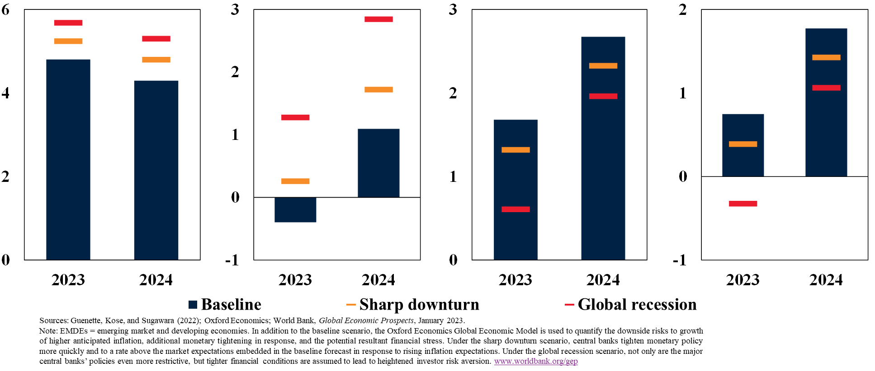
Global Growth Scenarios for 2023-24
Heightened Risk of Global Recession with Higher Interest Rates
Nominal short-term interest rate
(Percent)
Real short-term interest rate
(Percent)
Global growth
(Percent)
Global per capita growth
(Percent)

Slide 9
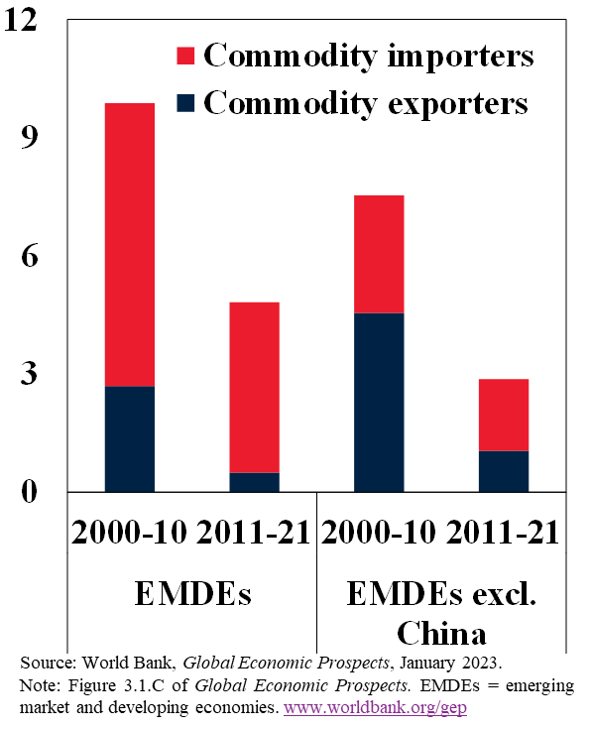
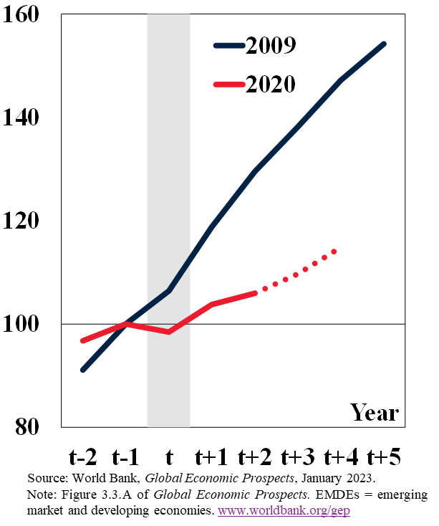
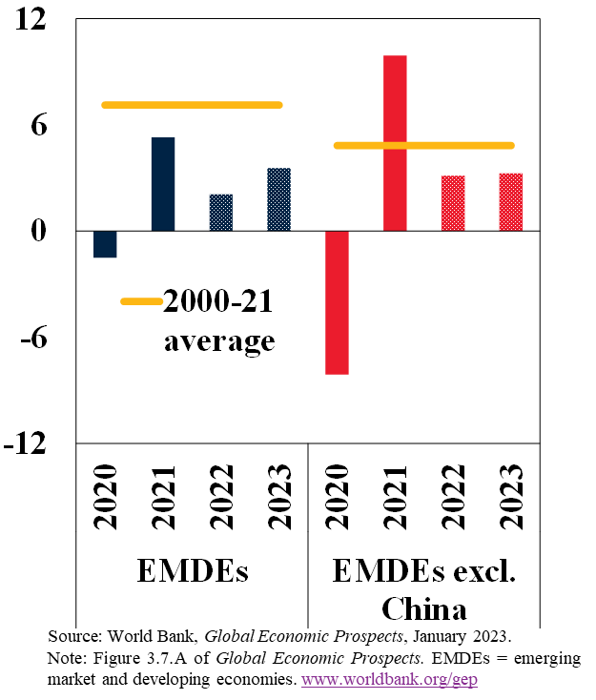
Investment in EMDEs
Weaker Growth during the Past Decade; Slower Recovery Going Forward
Investment growth, 2000-21
(Percent)
Investment in EMDEs
(Index, t-1 = 100)
Investment growth, 2020-23
(Percent)
Notes:
As the COVID-19 pandemic began, EMDEs had experienced a years-long slowdown in real investment growth spanning much of the previous decade, from nearly 11 percent in 2010 to 3.4 percent in 2019. The slowdown during the 2010s was broad based, occurring in all EMDE regions, in both commodity-importing and commodity-exporting country groups, and in a large share of individual economies. But the contribution of China to this trend was also remarkable, as shown in the difference between the first and the second set of bars in the left panel.
The pandemic triggered an investment contraction of nearly 2 percent in EMDEs in 2020, as you can see in the center chart. This was quite different than the experience of all EMDEs during the last global recession, in 2009. In 2020, about 70 percent of EMDEs experienced an investment contraction, compared to 55 percent in 2009. The recovery of investment following the 2020 global recession has also been substantially weaker than after the 2009 global recession. By the end of 2024, five years after COVID-19 was first detected, investment in EMDEs is projected to be about 15 percent higher than in 2019. In the five years following the 2009 global financial crisis, investment in EMDEs grew almost 50 percent.
In the near term, investment growth is projected to be below its average during the past two decades in both EMDEs and EMDEs excluding China. Investment growth is projected to be below the individual country trend of the past 20 years for about three-fifths of EMDEs. Continued weak investment growth has lasting implications for potential growth and EMDEs’ ability to reach key development and climate-related goals.

Slide 10
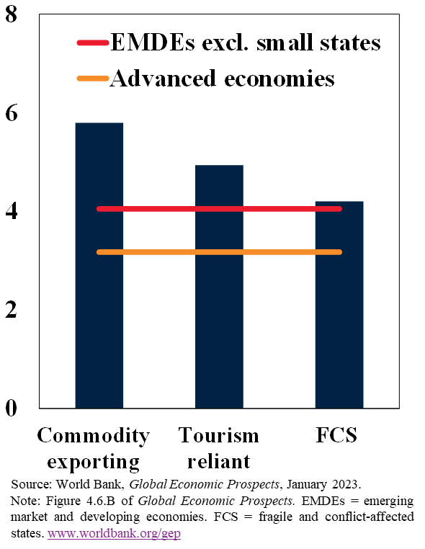
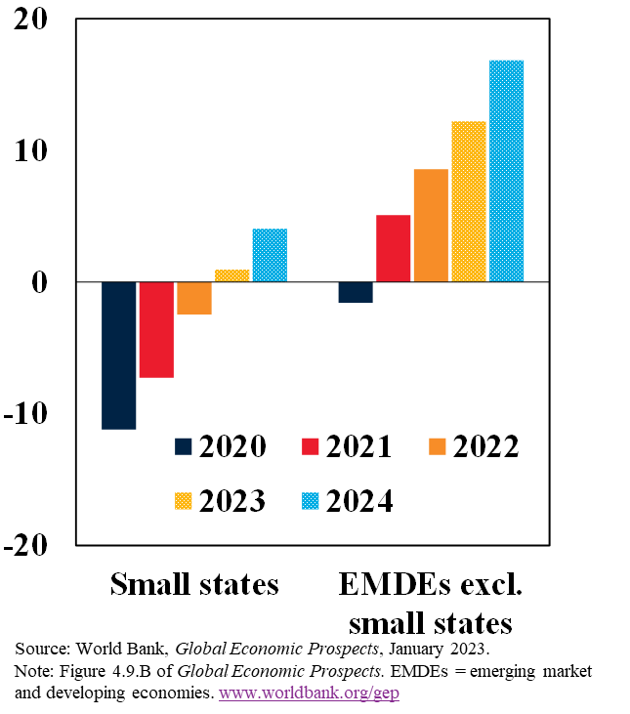
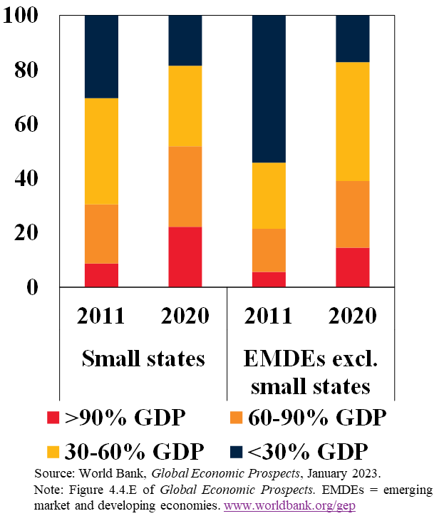
Volatility, Growth, and Debt in Small States
Higher Volatility; Weaker Recovery; Larger Debt
Growth volatility in small states
(Standard deviation)
GDP compared to pre-pandemic level
(Percent difference from 2019)
External debt
(Percent of countries)
Notes:
1) the characteristics described in the previous slide make growth in SSs unusually volatile. 2) We saw this illustrated dramatically during the pandemic, when SSs experienced an atypically severe recession. 3) SSs are expected to recover from this very slowly.
Small states suffered a particularly severe recession in 2020, both compared to their historical experience and compared to other EMDEs.
Their reliance on tourism left small states very exposed when the pandemic essentially shut down global tourism for an extended period. The extent of the tourism collapse in many small states was compounded by extensive pandemic-related
restrictions that were implemented to protect public health in contexts of limited health system capacity. Restrictions in small states generally remained tighter for longer than in other EMDEs, but converged to the EMDE average in mid-2022.
Even prior to the pandemic, however, small states were not growing robustly. Since 2000, average growth in small states has been slower and more volatile than in other EMDEs. In the decade prior to the pandemic, growth in small states decelerated to just 1.8 percent per year, in part due to the outsized effects of natural disasters and spillovers from slower global growth, but also due to markedly weak growth in energy exporting small states following the 2014 commodity price bust. Overall, small states have made no relative gains toward advanced economies’ per capita GDP levels since 2000. This lack of convergence was broad-based across small states in all regions. The knock-on impacts of the war in Ukraine and the ongoing global tightening cycle have further set back the recovery to pre-pandemic output levels.
The very large contraction of tourism during the pandemic is the most recent example of the downside of heavy reliance on a particular sector. More generally, a high degree of economic concentration has contributed to more volatile business cycles in small countries than in larger countries, with deeper cyclical contractions, shorter expansion and more procyclical exports and inflation

Slide 11
Policy Priorities - 1
Need for Global Cooperation and Macroeconomic Stability
Global policy challenges
Monetary and financial policy challenges
Fiscal policy challenges
Mitigate risk of global recession by implementing transparent, consistent and credible policies
Address debt distress in EMDEs, especially frontier markets and LICs
Bolster international cooperation to reduce food insecurity and avoid protectionist measures
Tighten policy to the extent needed to ensure inflation expectations well anchored
Curtail inefficient spending, including by moving away from/repurposing expensive and regressive subsidies
Set the foundations for GRID by tackling climate change and accelerating energy transition
Improve revenue collection by broadening tax base and improving tax administration
Strengthen macroprudential policy to reduce vulnerability to capital outflows and currency pressures
Communicate policy actions clearly, leverage credible frameworks, and safeguard central bank independence
Enhance efficiency of critical productive spending while providing targeted support to vulnerable groups
Strengthen fiscal frameworks and debt management

Slide 12
Policy Priorities - 2
Implementing Policies to Boost Growth and Resilience
Boosting investment
Strengthening resilience and inclusion
Improving growth and resilience in small states
Strengthen investment to meet development and climate goals
Establish flexible social protection systems to support vulnerable groups during major shocks
Enable diversification through digitalization, reducing trade costs, and fostering new industries (e.g., eco-tourism)
Reduce food insecurity by avoiding market distortions and pursuing investments in agricultural R&D, diversification of food sources, and targeted interventions such as nutrition programs
Increase female labor force participation and promote financial inclusion
Improve governance frameworks and business climates to foster private investment
Facilitate trade and global value chain integration and digitalization to attract private investment
Improve public spending efficiency, reallocate spending towards priority investments
Streamline regulatory environment to encourage private investment
Invest in climate adaptation and domestic renewable energy sources
Ensure disciplined financial management of state-owned enterprises
Establish fiscal mechanisms (e.g., fiscal rules, disaster stabilization funds) to enhance disaster risk management
Notes:
In view of the growing effects of climate change in small states, explicitly incorporating climate adaptation costs into domestic budgets has become more urgent. There is no way for small states to entirely offset the disruption that climaterelated and natural disasters will bring. However, a holistic, integrated approach to crisis preparedness can reduce the economic and human impact of these events by investing in both ex ante disaster resilience (market insurance, self-insurance, and self-protection) and ex post disaster recovery. Successfully boosting resilience to climate change without sacrificing broader development objectives requires policy reforms, reallocating public resources, mobilizing private capital, and financial support from the global community.

Slide 13
Questions & Comments
January 2023
www.worldbank.org/gep
Notes:
Also, you can find more detail in our publications that can be accessed at the following links. With this, thank you very much.

Slide 14
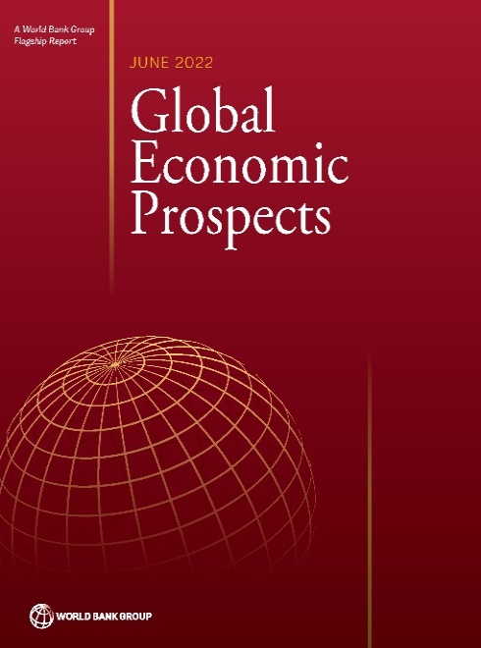
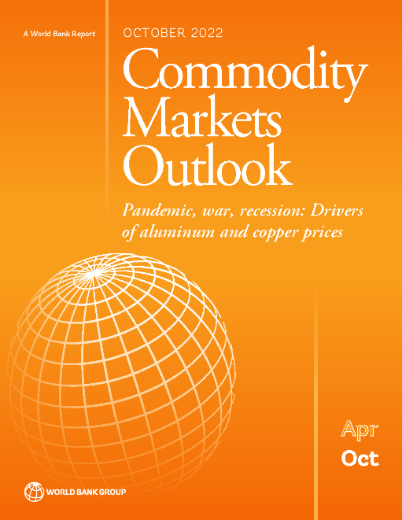
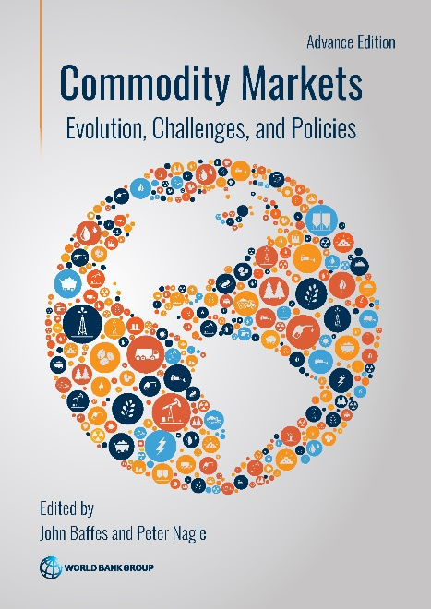
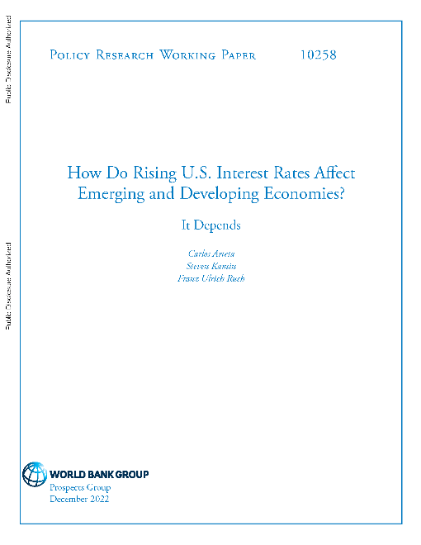
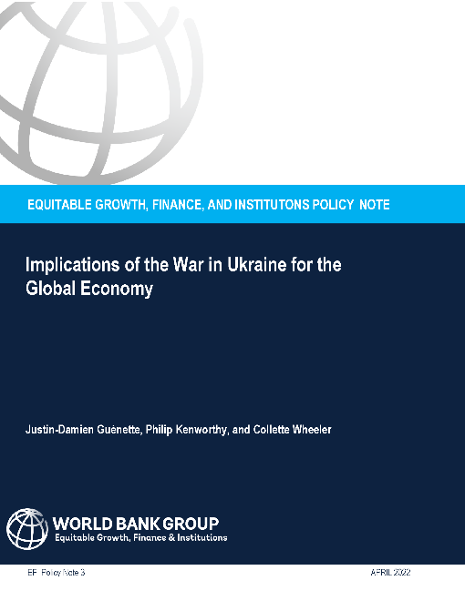
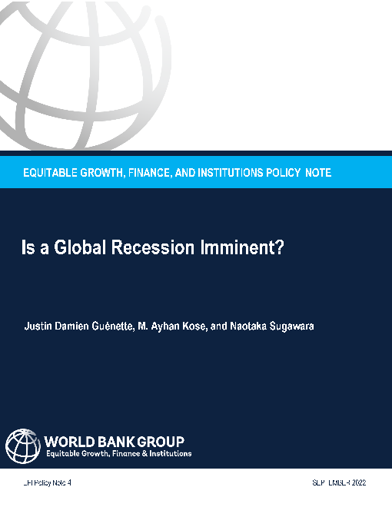
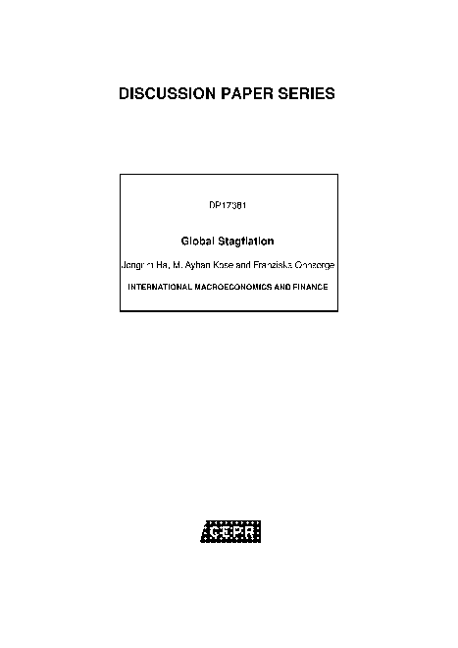
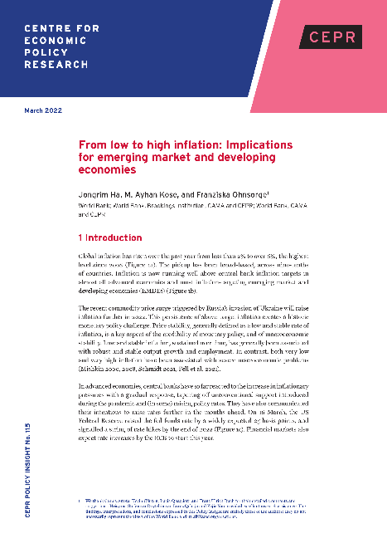
Recent Publications on Topical Global Macro Challenges

